Slide 1
SYSTEM CALLS
System calls provide the interface between a process and the operating system.
Typically written in a high-level language (C or C++)
Mostly accessed by programs via a high-level Application Program Interface (API) rather than direct system call use
Three most common APIs are Win32 API for Windows, POSIX API for POSIX-based systems (including virtually all versions of UNIX, Linux, and Mac OS X), and Java API for the Java virtual machine (JVM)

Slide 2
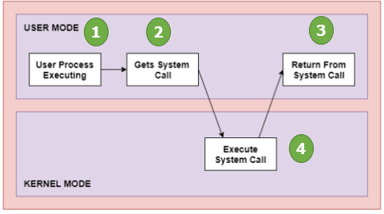
SYSTEM CALLS

Slide 3
Three general methods are used to pass parameters between a running program and the operating system.
Simplest approach is to pass parameters in registers.
Store the parameters in a table in memory, and the table address is passed as a parameter in a register
Push (store) the parameters onto the stack by the program, and pop off the stack by operating system.

Slide 4
TYPES OF SYSTEM CALLS
System calls can be grouped roughly in to five categories:
Process control
File management
Device management
Information maintenance
Communications

Slide 5
Types of System Calls
Process control
end, abort
load, execute
create process, terminate process
get process attributes, set process attributes
wait for time
wait event, signal event
allocate and free memory
File management
create file, delete file
open, close file
read, write, reposition
get and set file attributes

Slide 6
Types of System Calls (Cont.)
Device management
request device, release device
read, write, reposition
get device attributes, set device attributes
logically attach or detach devices
Information maintenance
get time or date, set time or date
get system data, set system data
get and set process, file, or device attributes
Communications
create, delete communication connection
send, receive messages
transfer status information
attach and detach remote devices

